Slide 1
Customer retention case study
S.Padmavathi

Slide 2
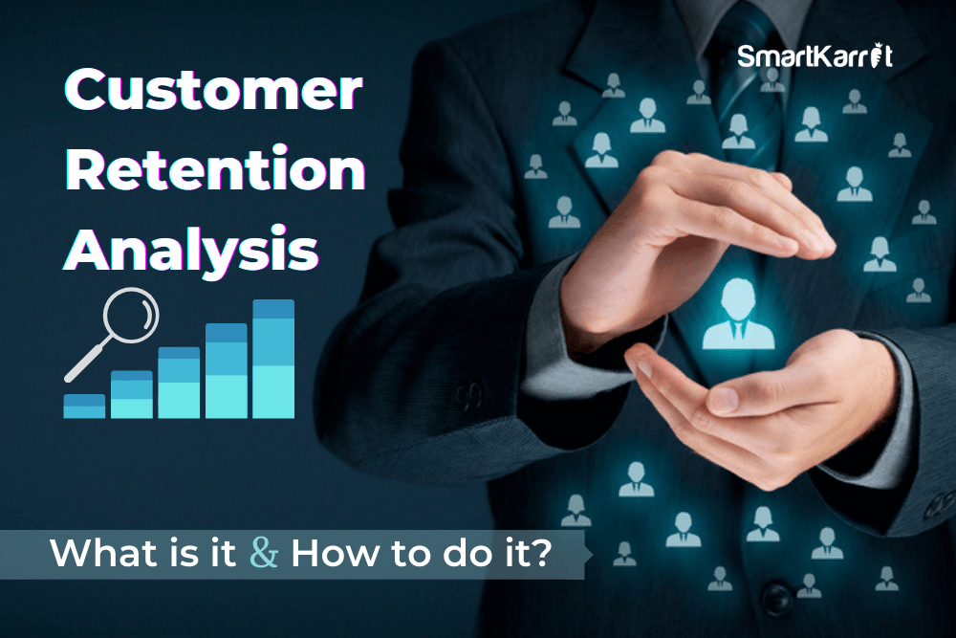

Slide 3
What is (cr)customer retention
What is customer retention?
Customer retention is a metric that measures customer loyalty, or the ability for an organization to keep its customers over time.
In addition to identifying the number of loyal customers, customer retention can reflect or predict customer satisfaction, repurchase behavior, customer engagement and emotional ties to a brand.

Slide 4
Introduction​
Primary goals
​Areas of growth
Timeline
​Summary​

Slide 5
PRIMARY GOALS
Annual revenue growth

Slide 6
Why is customer retention important for businesses?
if an organization does not focus on customer retention but instead focuses solely on expanding its customer base, it is potentially losing out on repeat customers.
While the process of gaining new customers, or customer acquisition, is important, it is also much more expensive.
Maintaining customers and transitioning them into recurring customers is just as important of a process as gaining new ones.

Slide 7
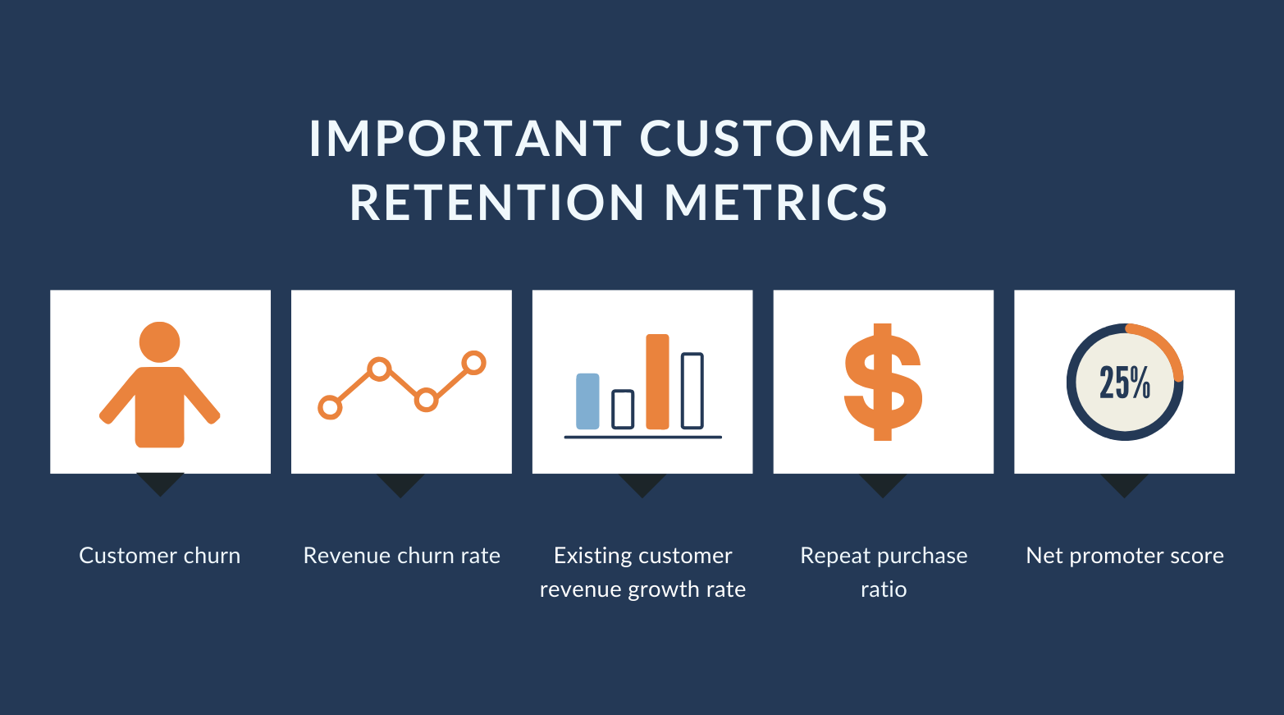

Slide 8
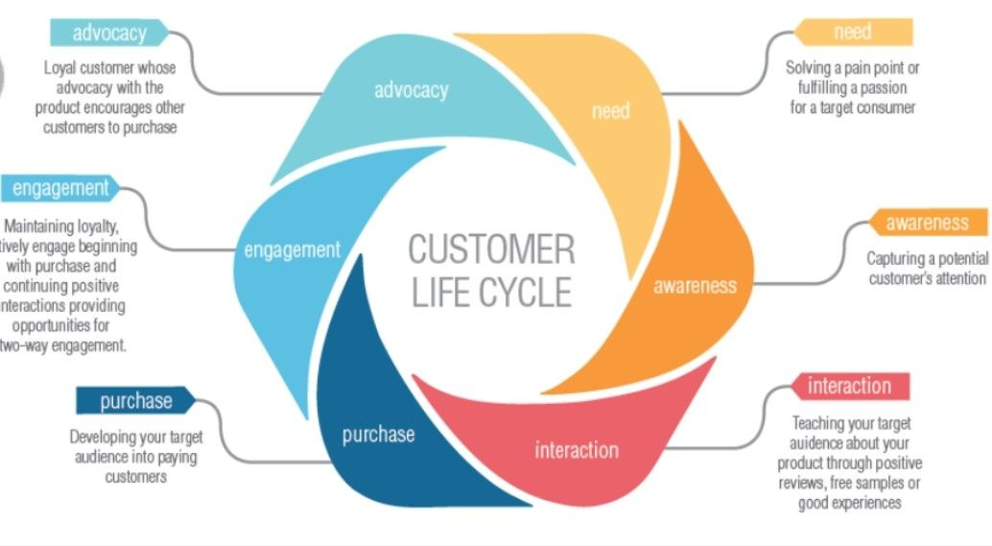
Customer lifecycle

Slide 9
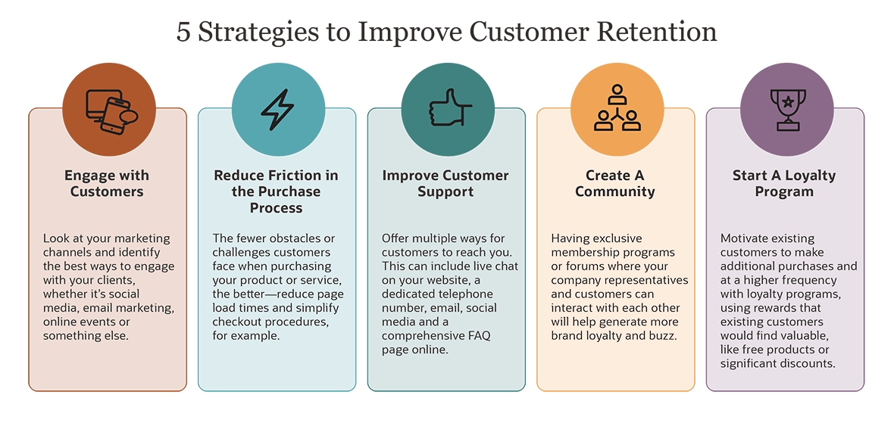

Slide 10

Factors of cr

Slide 11
How to measure customer retention and key metrics
Customer retention is typically measured in terms of retention rate and should be monitored continuously.
The first step to determining this rate is to identify the period of time an organization wants to record.
This can range from a month to a fiscal year or beyond.

Slide 12
AREAS OF FOCUS
factors used to determine the retention rate
example
the number of customers in the customer base at the start of the period (S);
the number of customers at the end (E); and
the number of new customers acquired over time (N).
These metrics should be recorded. Once retrieved, the formula is applied as follows:
E-N/S x 100 = retention rate
if an organization starts with 750 customers and ends with 950, but acquires 625 over the period of time, the customer retention rate would be 43.3%.

Slide 13
SUMMARY
Customer retention has a direct impact on profitability. Research by John Fleming and Jim As plund indicates that engaged customers generate 1.7 times more revenue than normal customers, while having engaged employees and engaged customers return a revenue gain of 3.4 times the norm.
The International Customer Service Institute (TICSI) has released The International Standard for Service Excellence (TISSE 2012). TISSE 2012 enables organizations to focus their attention on delivering excellence in the management of customer service, whilst at the same time providing recognition of success through a 3rd Party certification scheme.

Slide 14
THANK YOU
S.Padmavathi
spadmashivu556@gmail.com

